Slide 1
Adversarial Attacks on Load Forecasting Model
Presented By: Saurav Kumar (B20EE081) (Department of Electrical Engineering, IIT Jodhpur)

Slide 2
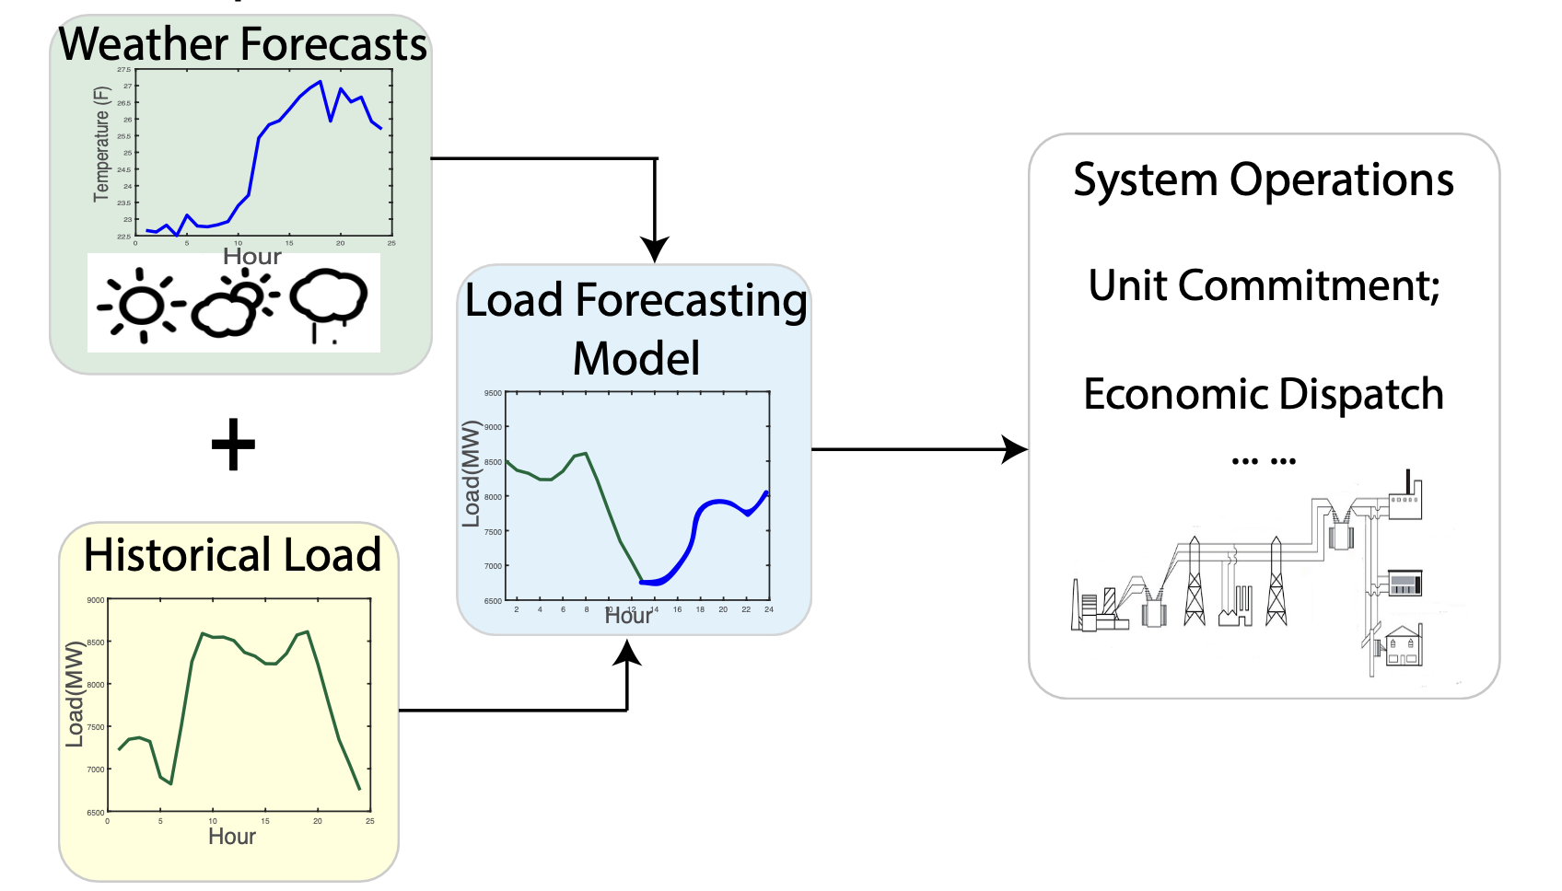
Introduction
Why Load Forecasting?
Load forecasting plays an important role in the planning and operations of power system.
It is useful in various decision-making problems such as unit commitment, reserve management, economic dispatch and maintenance scheduling.
Problem with Load Forecasting Model?
The driving factors of load variations are heterogeneous, including temperature, weather, temporal effect, seasonal effects and other socioeconomic factors.
Load Forecasting model uses the temperature and weather forecasts as its input features which comes from external services/APIs, while such inputs can be exposed to adversarial modification and the model accuracy may be severely impacted by such malicious changes in dataset.
The accuracy of forecasted load directly impacts the cost and reliability of power system operations.
Recently, there has been a hot debate on the security of machine learning models and researchers found that small noises injected to input features can severely impact model performance.

Slide 3
Problem Statement
In this work, we have investigated the security threats of load forecasting model.
We considered the scenario where attacker adversarially injects false data into the input features and examined to what extent such attacks could impact the performance of load forecasting model.
Specifically, we investigated false data injection attacks on the temperature features. It is an important input feature and is mostly obtained from external services/APIs. So, it is easier for attackers to inject perturbations on temperature data.
We have also implemented Black-box attack algorithm Gradient Estimation to generate hard-to-detect adversarial temperature data.
We will see that strategically designed adversarial input features can impact performance of load forecasting model.
This can result into potential damages on power system operations either by increasing system operating costs or load shedding events.

Slide 4
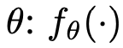
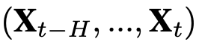
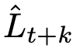
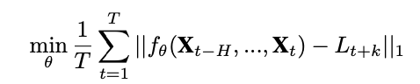
Load Forecasting Model
LSTM Based Recurrent Neural Network
To model the temporal dependencies in sequential data to forecast values, Recurrent Neural Network (RNN) is widely used forecasting model.
We have used LSTM Based Recurrent Neural Network to find function parameterized by which learns the mapping from historical sequence to future loads .
Forecasting goal is to find which minimizes our Cost Function:
We have used Mean Absolute Percentage Error (MAPE) to measure the forecasting performance.

Slide 5
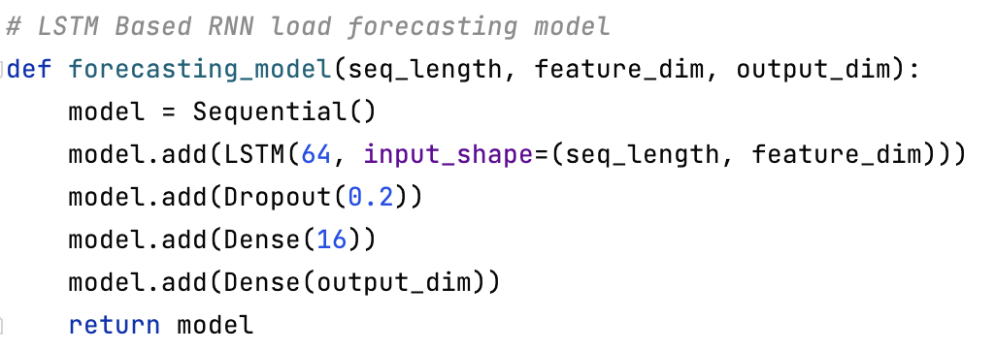
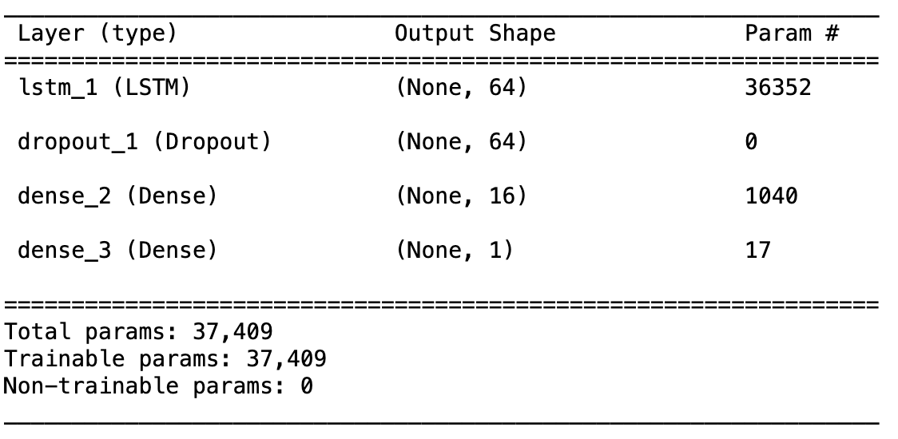
Load Forecasting Model
Model Architecture

Slide 6
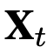
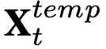
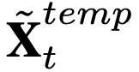
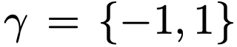
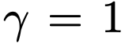
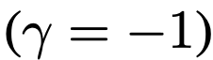
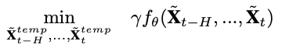
Adversarial Attacks Strategy
Adversarial Attacks
To distort the forecasted values, the attacker has two choices of inserting attack: 1) To attack input features which is called Black-box attack strategy or 2) To attack model parameters which is called White-box attack strategy
Trained model parameters often kept safely by the operators. So, it’s not easy to do White-box based adversarial attack.
Load Forecasting model uses external data such as temperature forecasts as its input feature which generally comes from external services/APIs. This provides a backdoor for the attacker to implement Black-box attack strategy to adversarially modify the temperature data.
Attacker Objective
The attacker goal is to generate adversarial temperature data which can distort the forecasted load as much as possible.
We defined to denote the attack direction by attackers. If the attacker want to decrease (minimize) the forecasted load and If the attacker want to increase (maximize) the forecasted load.
Since forecasted load is always positive, we can combine both cases and write attacker goal as:

Slide 7
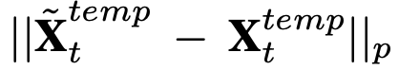
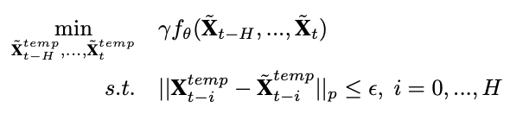
Adversarial Attacks Strategy
Attacker Knowledge
We will assume the attacker has access to query the trained load forecasting model for a limited number of times.
Attacker Capability
From the attacker perspective, it is necessary to construct adversarial data which should not be detected by the power system operator’s bad data detection algorithms.
So, attacker want to keep bounded.
We can mathematically formulate the Attacker Adversarial model as the below optimization problem:

Slide 8
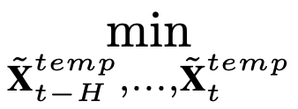
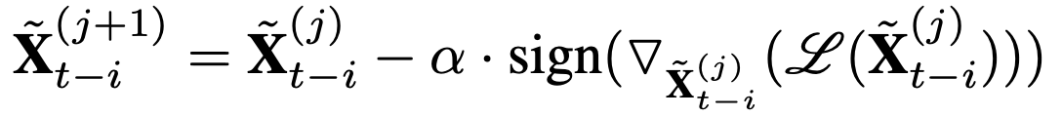
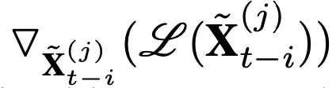
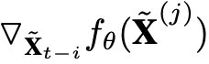
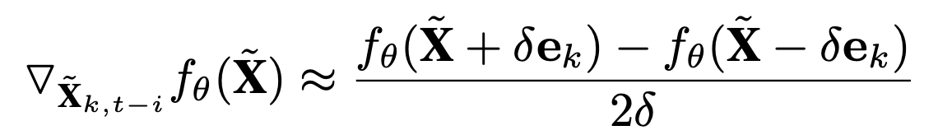
Gradient Estimation
We can reformulate the Attacker Adversarial Model from constrained optimization to unconstrained optimization problem using Log Barrier Method as:
Then, we can use Gradient Descent algorithm to find suboptimal solution of above problem:
But we won’t be able to compute gradient directly due to lack of knowledge about model parameter in the Black-box attack strategy.
We can approximate the gradient of using Finite Difference Method because attacker can query the trained load forecasting model for a limited number of times (attacker knowledge): (Using Finite difference method)

Slide 9
Experimental Setup
Dataset Used
1. ENTSO-E Dataset (European Network of Transmission System Operators for Electricity) for hourly load data in Switzerland. 2. DarkSky Dataset for hourly temperature and weather Icon information of 8 major cities in Switzerland.
Dataset Raw Features
There are 21 raw features at each timestamp: 1. Load 2. 8 Cities temperature 3. 8 Cities weather Icon Information - categorical features 4. Holiday - Boolean tells weather holiday in Switzerland 5. Month - categorical feature tells data of which month 6. Day - categorical feature tells data of which day 7. Hour - categorical feature tells data of which hour
RNN Model Hyperparameters
SEQ_LENGTH = 24 (Take past 24 timestamp data for forecasting) FORECAST_HORIZON = 1 (Want to forecast at t+1 time) TRAIN_NUM_EPOCHS = 30 (Number of epochs for training model) BATCH_SIZE = 32 (Number of Batch Size) FEATURE_DIM = 77 (Feature dimension at each timestamp) Optimization Algorithm: Adam is used
Gradient Estimation Hyperparameters
ALPHA = 0.01 (Learning rate for Gradient Descent) GRAD_NUM_EPOCHS = 10 (Number of epochs to optimize) DELTA = 0.05 (Step size for FDM) BETA = 0.9 (Barrier Constant) TEMPERATURE_VARIATION = 5 (Maximum temperature variation in F) Optimization Algorithm: Gradient Descent is used

Slide 10
Results
Model Results
We can see that training loss decreases with epochs.
MAPE for training dataset is 1.343 which shows that our forecasting model has trained very well.
MAPE for test dataset is 3.885 which shows that our forecasting model has also performed very well.

Slide 11
Results
Adversarial Attacks Results
From Temperature Profile, we can see that we have generated hard-to-detect adversarial temperature data using Gradient Estimation for various maximum degree of temperature variation (in Fahrenheit).
From Load Profile, we can see the effect of adversarial temperature features which has impacted the performance of load forecasting model.
We can see that the load forecasting model performance decreases with increase in degree of temperature variation.

Slide 12
Results
Adversarial Attacks Results
We can see and compare the Load Forecasting Profiles with 1F and 5F attack. 5F attack has deviated the forecasted load more and hence performed worse as compared to 1F attack.
From MAPE vs Temperature Variation curve in right, we can see that the test dataset MAPE has increased with increase in degree of temperature variation.
We can see with only 5 Fahrenheit change in temperature which is not much, MAPE has increased from 3.88 to 4.23, that is increase of approx. 9% in MAPE as compared to actual temperature dataset.

Slide 13
Conclusion
In this work, we have investigated the security threats of load forecasting model.
First, we have implemented LSTM based RNN architecture for load forecasting model and we saw that our forecasting model has performed very well on test dataset.
Secondly, we have implemented Black-box based attack strategy called Gradient Estimation to generate hard-to-detect adversarial data.
At last, We have seen that the adversarial attack has affected the performance of load forecasting model by good amount. This can impact cost and reliability of system operations and various decision-making problems such as unit commitment, maintenance scheduling etc.
This work shows that there is need of more secure and robust design and implementation of load forecasting algorithms.
The system operator’s bad data detection algorithms should be implemented robust using more advanced and sophisticated techniques like anomaly detection to detect even such type of adversarial attacks.

Slide 14
References
https://arxiv.org/pdf/1906.04926.pdf
https://transparency.entsoe.eu/
https://darksky.net/forecast/47.3769,8.5414/us12/en
https://keras.io/api/layers/recurrent_layers/lstm/
https://scikit-learn.org/stable/modules/generated/sklearn.preprocessing.StandardScaler.html
https://keras.io/examples/timeseries/timeseries_weather_forecasting/
https://www.stat.cmu.edu/~ryantibs/convexopt-S15/scribes/15-barr-method-scribed.pdf
Softwares & Libraries Used
Programming Languages: Python
Machine Learning Framework: Keras, Scikit-learn
Important Libraries: Pandas, NumPy, Matplotlib

